Slide 1
Game Project
RUNAWAY
Auston Lee and Justin Wang
INNOVATION

Slide 2
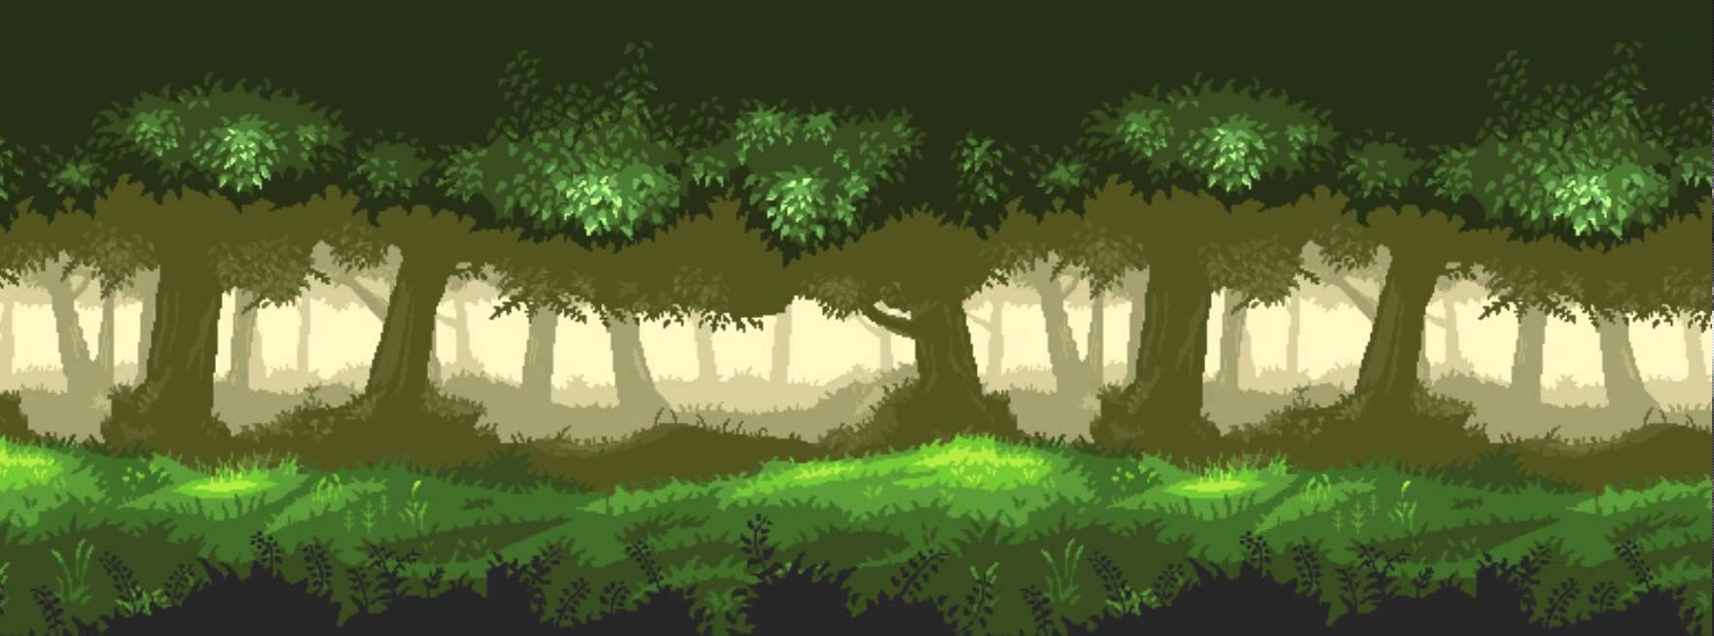

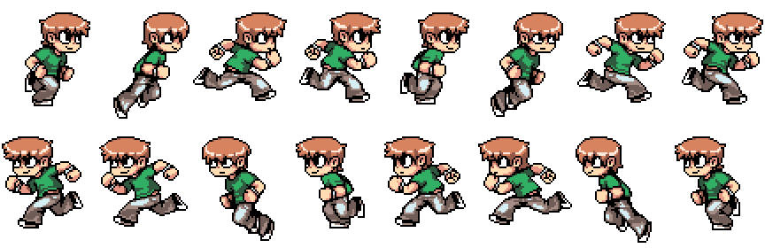
RUNAWAY
PRESS [SPACE] TO PLAY

Slide 3


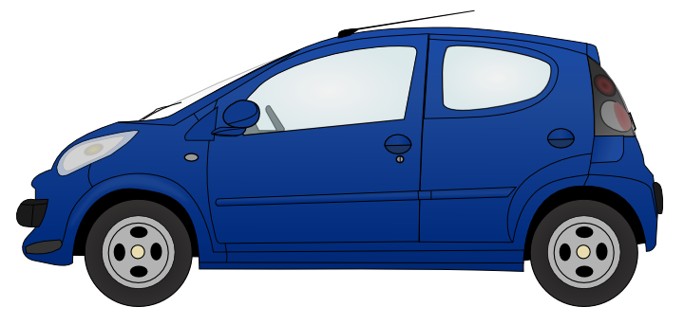
Health: 100
If spacebar is pressed the boy will jump
If the boy collides with a car his health goes down 10

Slide 4
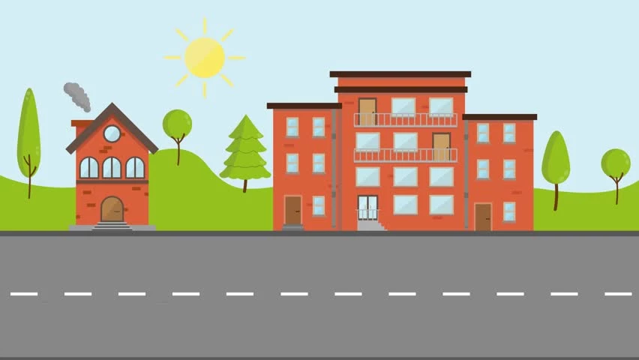
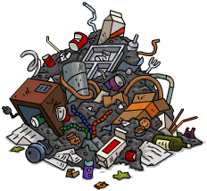
Health: 100-10+20
If the boy collects a heart his health goes up 20
If the boy collides with trash his health goes down 10

Slide 5


Health: 100
If the boy collides with a cactus his health goes down 10

Slide 6
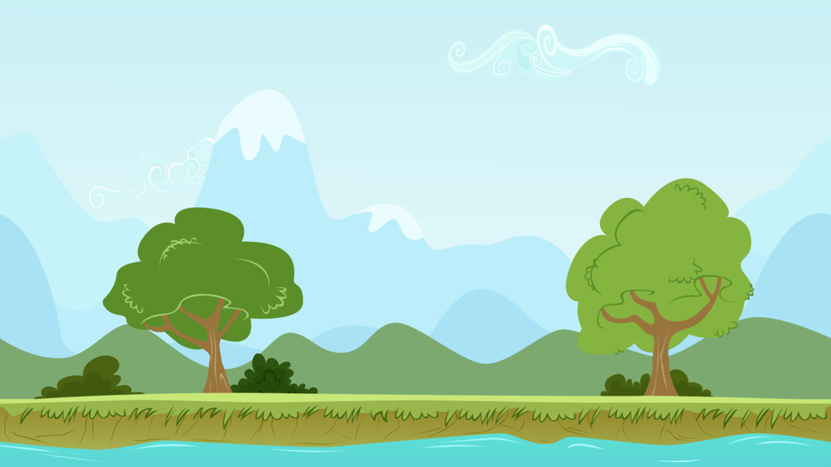
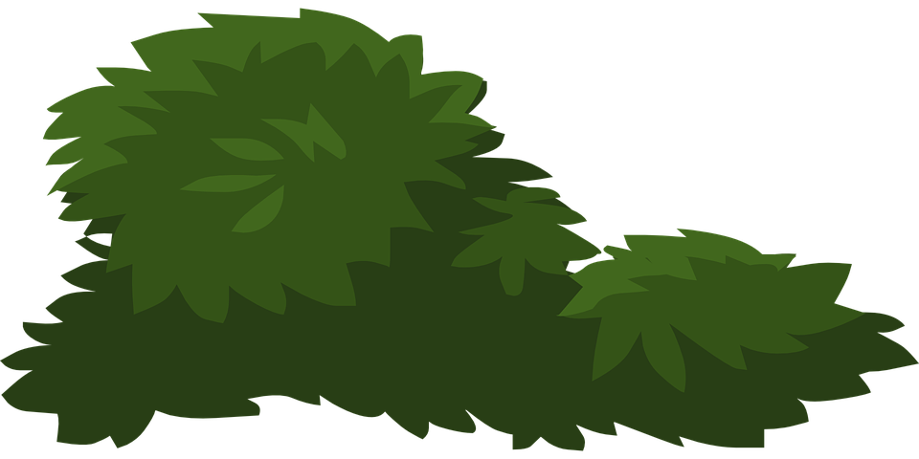
Health: 100
If the boy collides with a bush his health goes down 10

Slide 7

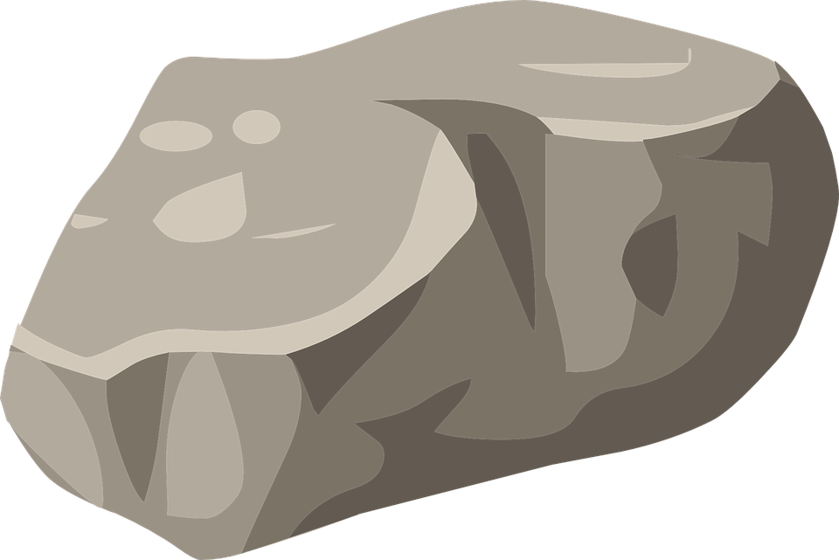
Health: 100
If the boy collides with a rock his health goes down 10

Slide 8
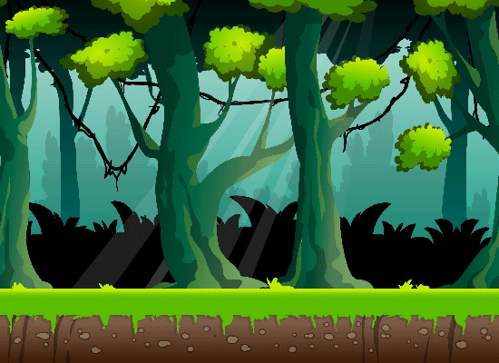

Health: 100

Slide 9
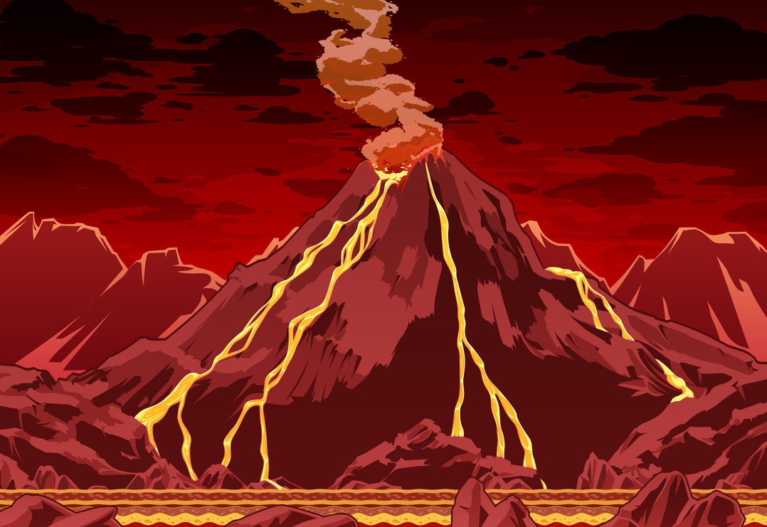
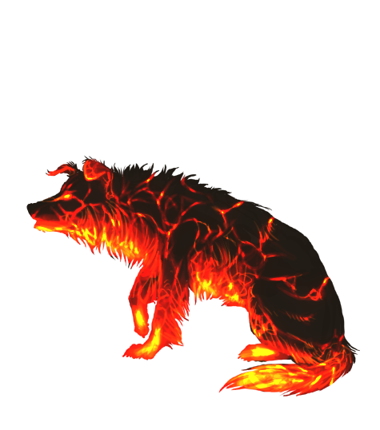
Health: 100
If the boy collides with a magma rock his health goes down 50

Slide 10
If the boy collides with the house the game is over

Slide 11
GAME OVER
HEALTH:80
PRESS [ESC] TO QUIT

